Slide 1
COVID-19 Virus Predicition of US
Team 2:
001056959 Jinnuo Che
001051249 Yu Ren
001089477 Jing Bian

Slide 2
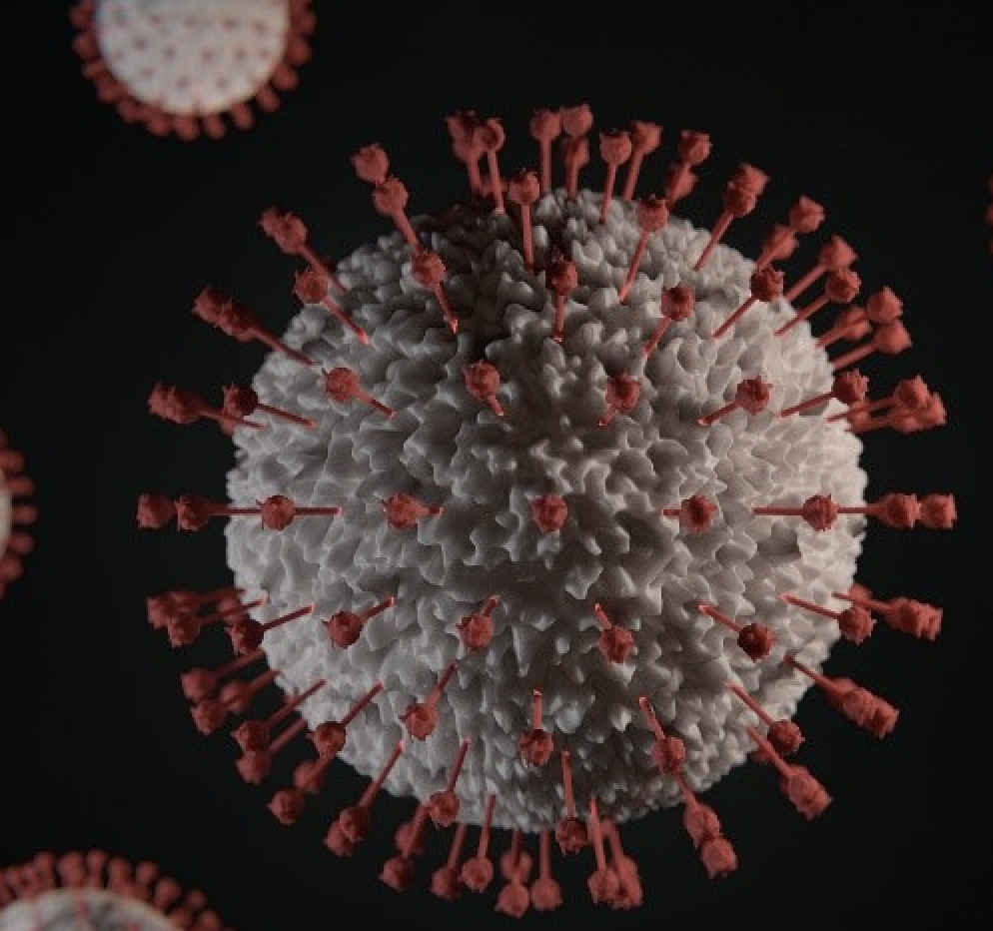
Introduction
Since the end of 2019, a new type of coronavirus pneumonia has erupted in China, and the epidemic has swept the country. It is another national spread of viral pneumonia after SARS. Now, outbreaks are happening all over the world, we plan to analyze the trend of the epidemic objectively in America so as to prevent and avoid the virus effectively.

Slide 3


Dataset
“COVID19.csv” is a dataset containing 41648 pieces of data about the virus situation changes in different countries. Each data contains information of date, country, country code and the numbers of confirmed, suspected, cured and dead people.

Slide 4
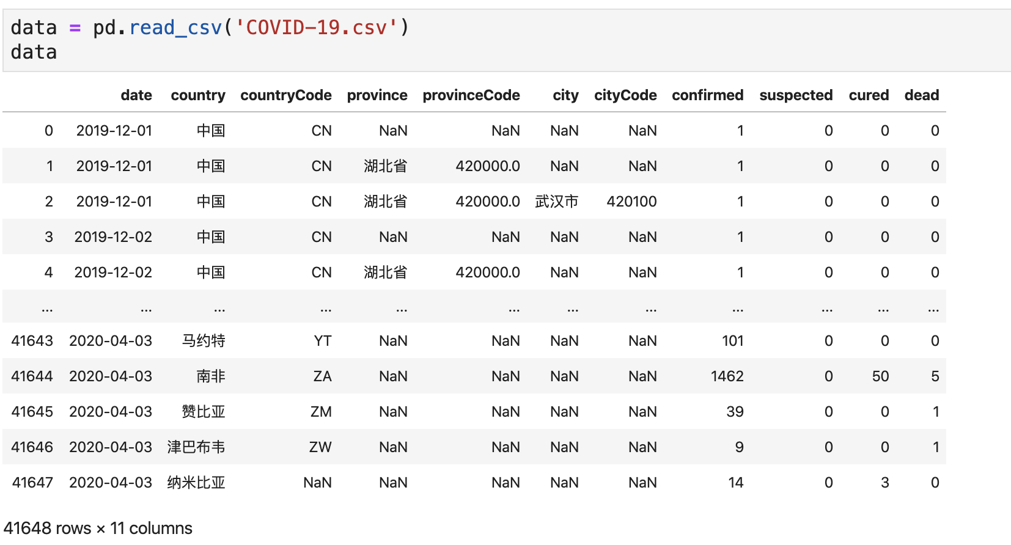

Slide 5
Model (Methodology)
SIR (Minimize)
SIR (pymc3)
Logistic (curve_fit)

Slide 6
SIR (Susceptible Infected Recoverd Model)
S(t) are those susceptible but not yet infected with the disease;
I(t) is the number of infective individuals;
R(t) are those individuals who have recovered from the disease and now have immunity to it.

Slide 7
β is the rate of infection per susceptible and per infective individual:
β is an average infected to non-infected individual contact (e.g. 4 individuals) and hinges on the underlying society. Arguably, it is higher in China where the population is denser. But it also high in very social Mediterranean countries like Italy and Spain.
γ is the rate of recovery: It can be interpreted as an average period of infectiousness (e.g. 3 to 5 days for the common flu). For Covid19, experts are astonished by how long an individual can infect others and say that it can be up to 30 days!
Susceptible
(S)
Infectious
(I)
Recoverd
(R)
𝛽
𝛾

Slide 8
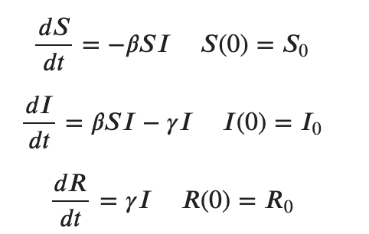
The differential equations for the SIR model of infection are:
The quantity β/γ is called R-Nought (R0). Its interpretation is that if we were to drop a single infected person into a population of susceptible individuals, we would expect R0 new infections. If R0>1, then an epidemic will take place. If R0≤1 then there will be no epidemic.
When R0<1, each person who contracts the disease will infect fewer than one person before dying or recovering, so the outbreak will fizzle (dI/dt<0). When R0>1, each person who gets the disease will infect more than one person, so the epidemic will spread (dI/dt>0).
R0 is the most important quantity in epidemiology.

Slide 9
β = k * infection_probability
Preprocess data
Use Minimize to compute the Infection Probability
Change the number of individuals that are contacted by each infected individual per day.

Slide 10
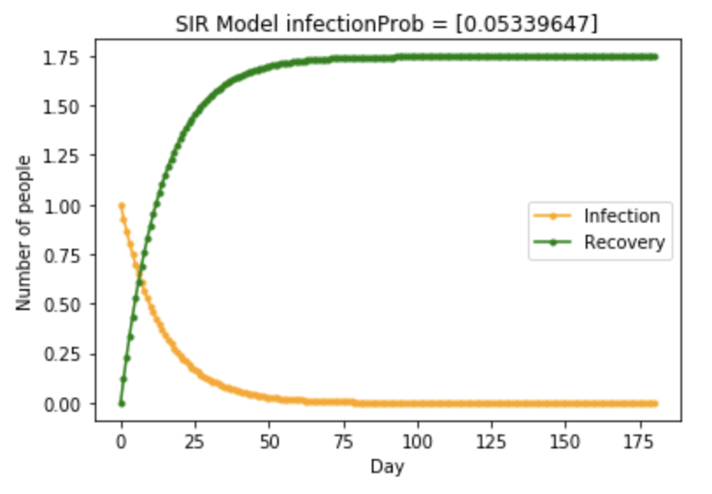
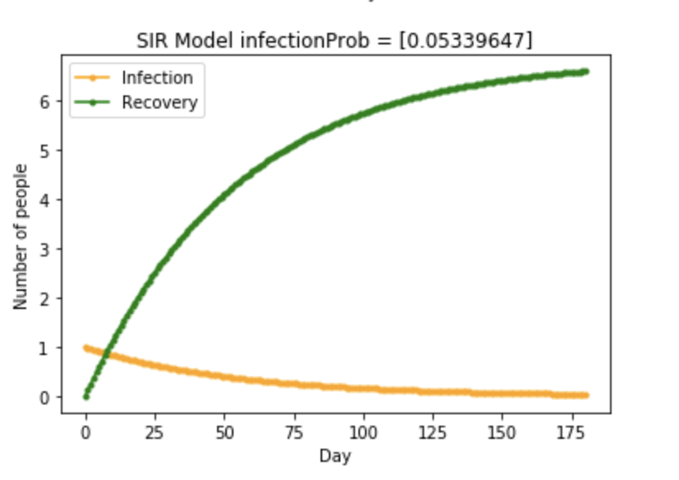
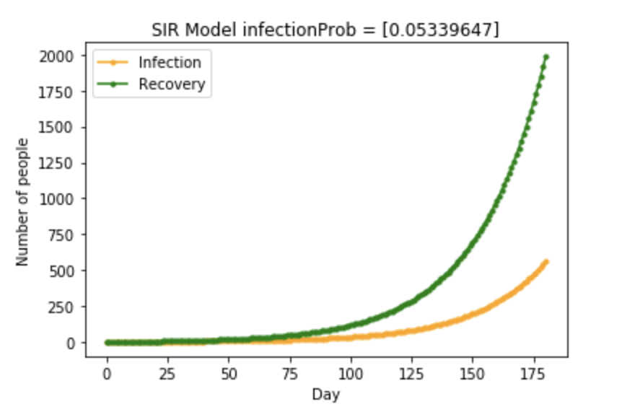
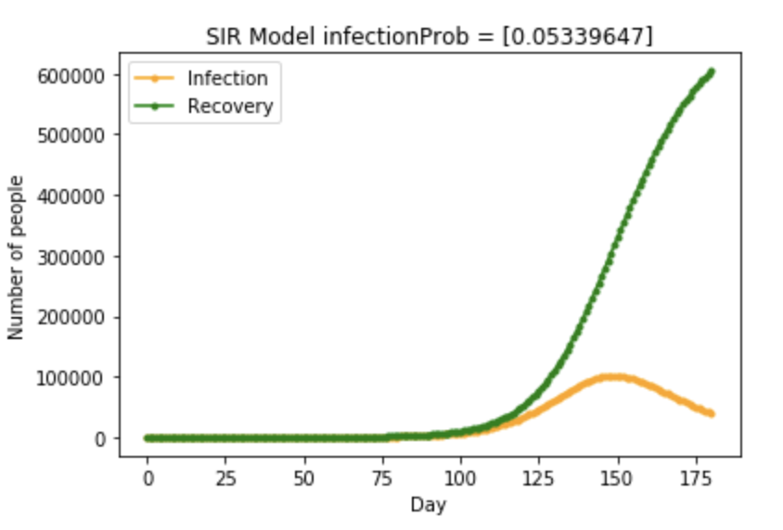
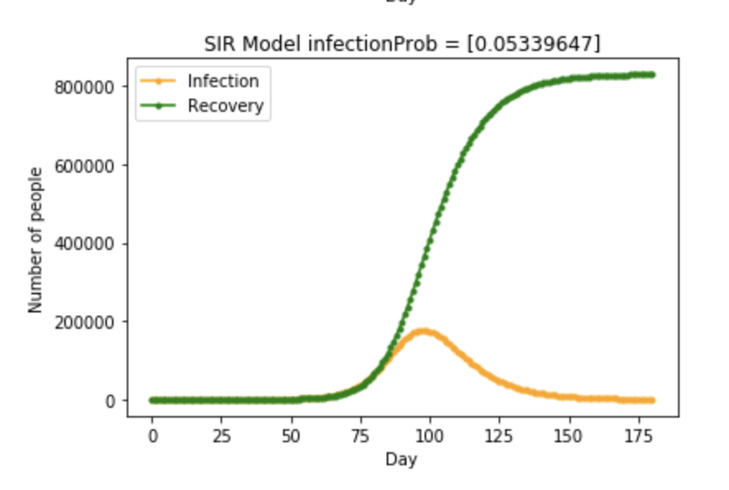
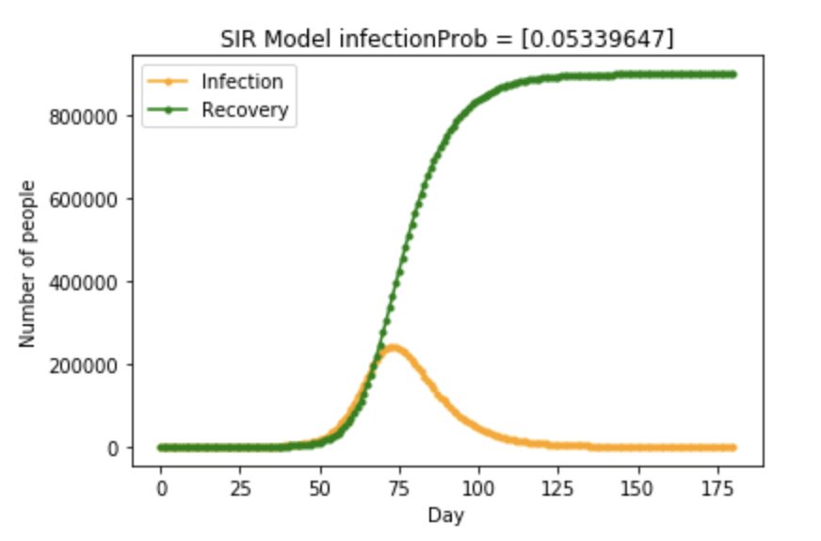
k = 1
k = 2
k = 3
k = 4
k = 5
k = 6

Slide 11
Analysis
Result analysis: The number of contacts has a great influence on the trend of the epidemic, so quarantine is very important in this situation. In real life, the epidemic has not spread as in the model, mainly because national policies and quarantine have effectively reduced R0 in the later period, so the number of infected people in the later period of the epidemic will show a decreasing trend.
Deficiencies: In the SIR model, β is obtained from the infection probability obtained after data analysis and the assumed k value. This β is not accurate enough. Can we process the known data and obtain a more accurate R0 to analyze the severity of the epidemic?

Slide 12

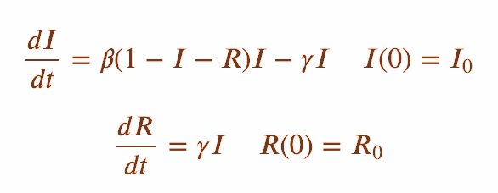
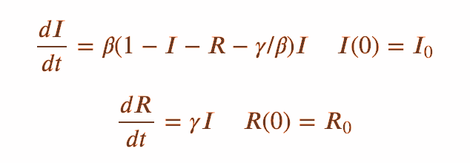
If we know R(t) and I(t) then we can determine S(t): S(t)=1−I(t)−R(t), so we can work only with the two unknowns: R(t) and I(t). We prefer to work with these because that is what the China Covid19 dataset gives us!
So we write:
Simplify

Slide 13
Preprocess data
Use Differential Equation to create SIR model
Assume that Wuhan I (infected) and R (recovered) data are log-normally distributed and use Bayesian model to compute the parameters.
Use the computed parameters to present the SIR modal

Slide 14
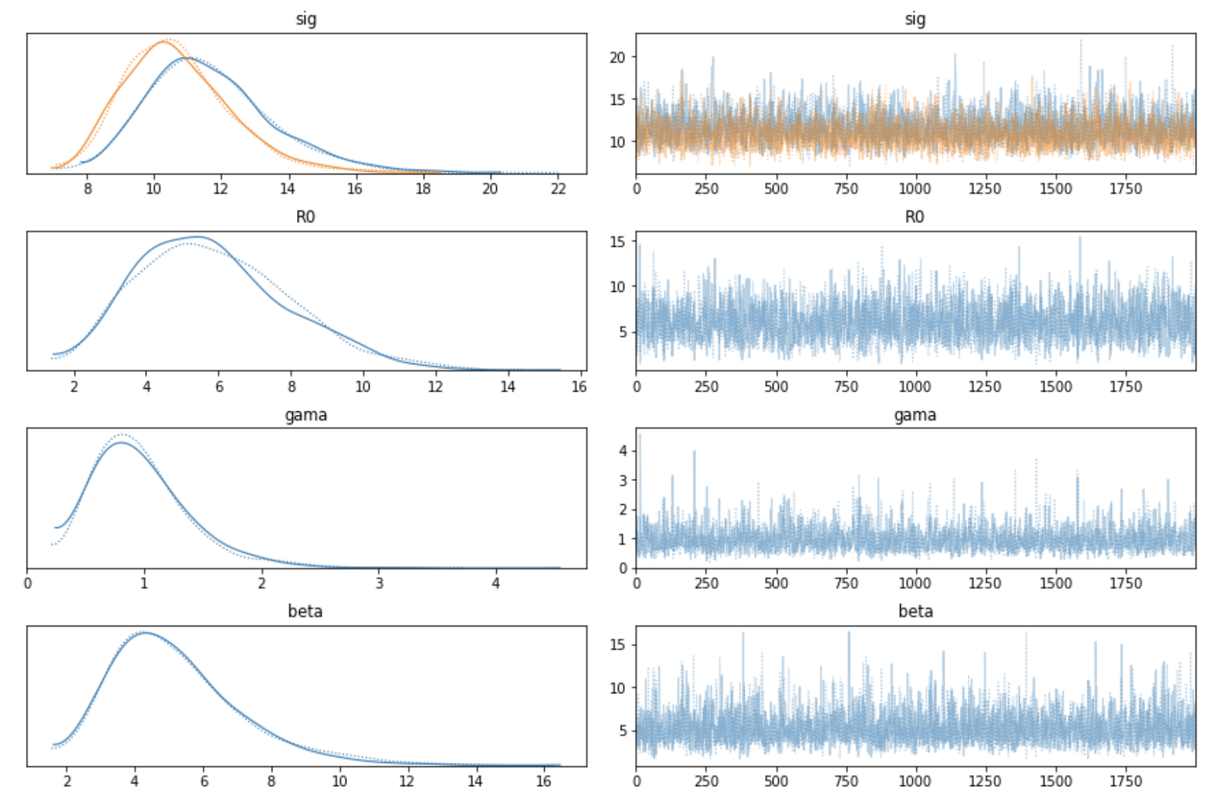

Slide 15
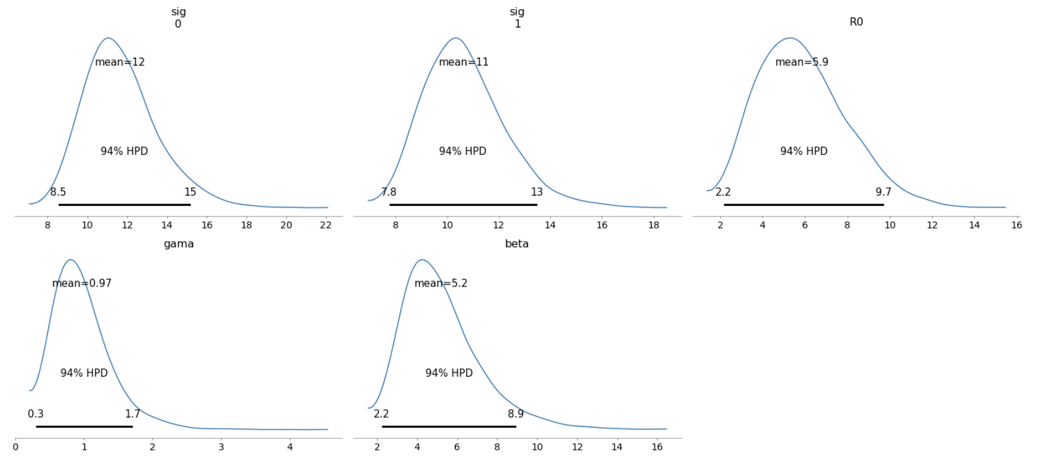

Slide 16
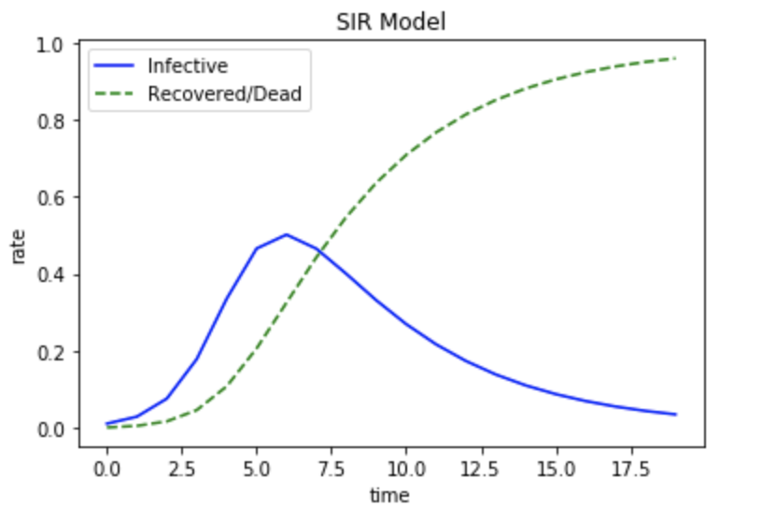
After taking the median of the results and re-displaying the SIR model, the results are shown in the left.
This model is similar to the known data shown in our first session and is more realistic.

Slide 17
Analysis
Result analysis:The parameter results we obtained after data processing are relatively accurate, and the drawing of these parameters conforms to the real situation.
Deficiencies:The SIR model predicts the epidemic according to the given 𝛽 and 𝛾, and the population parameters of this epidemic model need to be set by ourselves. It only considers the spread of the epidemic, but does not consider the resistance factors in reality. Can we find a model with consideration of resistance?

Slide 18
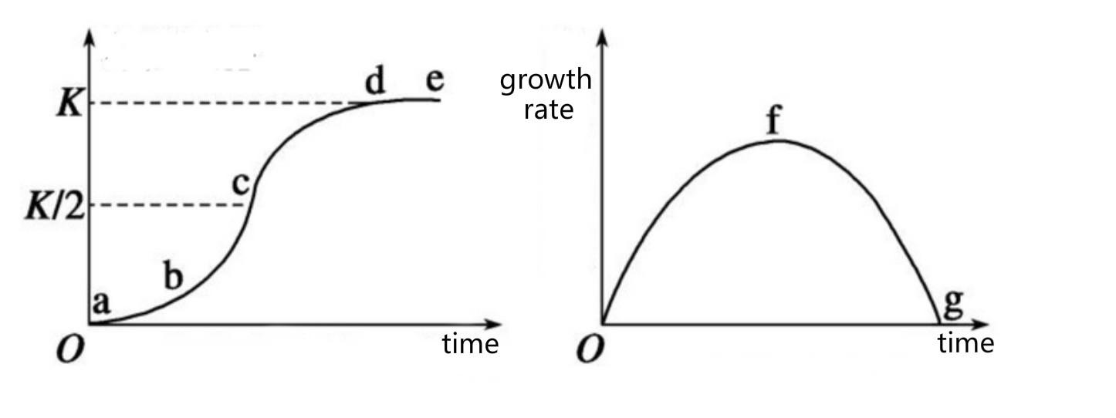
Logistic Model

Slide 19
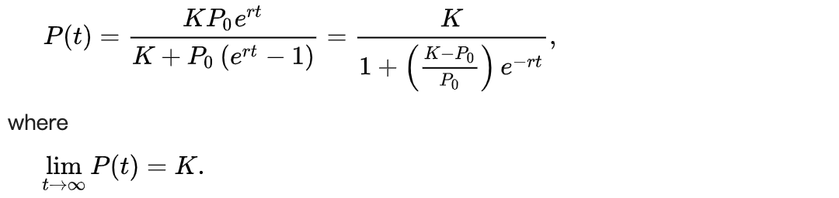
5 periods：
Initial: density growth is slow due to the small number of individuals in the population
Acceleration: density growth accelerates as the number of individuals increases
Transition: density increases fastest when the number of individuals reaches half of the saturation density (K / 2)
Deceleration: growth slows down when the number of individuals exceeds half of the density (K / 2)
Saturation: number of individuals in the population reaches K value and is saturated

Slide 20
Preprocess data
Use Curve Fit to compute capacity, intitial_value and increase_rate
Use Logistic Model to show the trend of confirmed population
Show the specific number confirmed people everyday in the future.

Slide 21
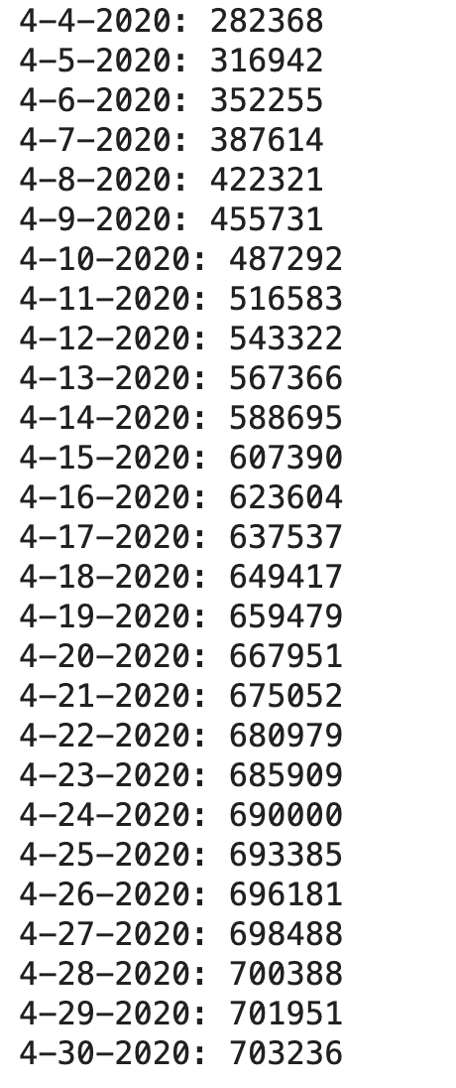
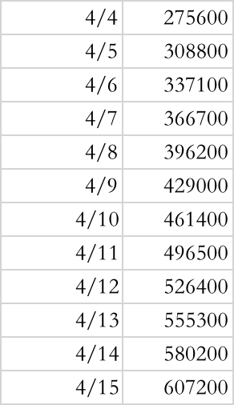
Prediction
Real

Slide 22
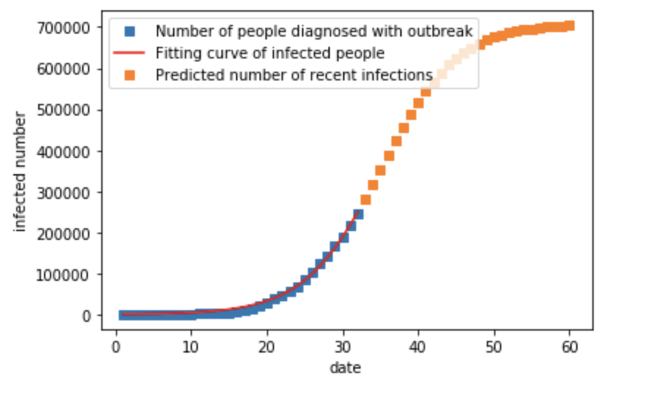

Slide 23
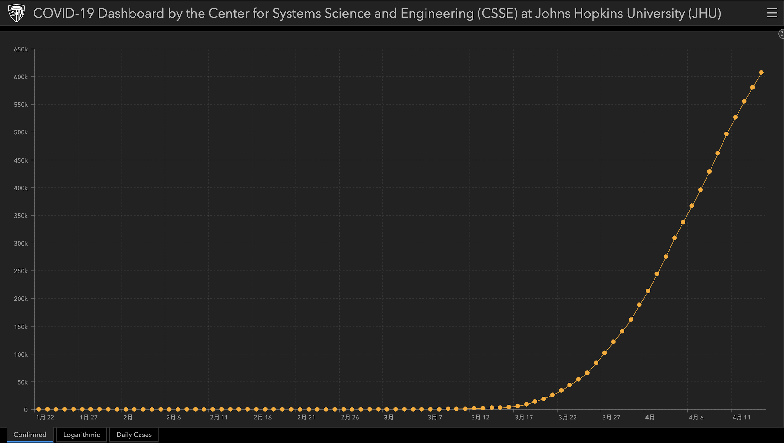

Slide 24
Analysis
Result analysis:According to the prediction curve and daily detailed results, compared with the new data in recent days, our prediction is more accurate. Especially in recent days, the data is more practical. We can now see that with resistance set to linear growth, the number of confirmed cases will reach 709k by the end of April (and we hope so). I hope that government policies and people's behavior can make the resistance grow in a straight line as expected.
Deficiencies:We set the initial value and growth rule of resistance by ourselves, so there are some subjective factors in predicting the trend of epidemic situation. In these two aspects, we may also use machine learning to make reasoning and judgment.

Slide 25
Conclusion
We know the trend of epidemic prediction displayed by SIR model under different R0, which let us know that human contact plays a decisive role in the trend of epidemic transmission.
We analyze the real R0 according to the known data, combined with the SIR model we have shown, we can know that the covid19 virus is a huge challenge for all human beings.
Based on the analysis of existing data and artificial judgment, we predict the rising curve of the number of confirmed cases in the United States under the assumption that the resistance increases linearly. We also hope that, as we predicted, the U.S. epidemic will gradually stabilize at the end of April, and we hope that the U.S. can get through the difficulties.

Slide 26


For SIR model, we may be able to dynamically analyze the change of R0 and predict its trend, so that SIR model can be more realistic.
In addition, for the initial number of people in SIR model, we can directly use the corresponding population instead, combining with the idea in 1, fitting a more real curve.
Because of the time limit, we only use one curve for the logistic model to speculate the resistance. Maybe we can use different curves and compare the results to find a more accurate one.
Future

Slide 27
References
https://www.kaggle.com/wang749/china2019ncov
https://blog.csdn.net/z_ccsdn/article/details/104134358
https://blog.csdn.net/source_code13/article/details/104164299
https://blog.csdn.net/weixin_44533530/article/details/104732733

Slide 28
Thank you!

